Slide 1

WAY TO ENTERPRISE
AWS
VTI ACADEMY
Author: duy.nguyenngoc1@vti.com.vn

Slide 2
Agenda
Opsworks Service
WorkSpaces / Workdocs / Workmail Service
Cost Management Service
Trusted Advisor Service
Batch Service
Other Service
Copyright © VTI Academy All Rights Reserved

Slide 3
Opsworks Service
Is a configuration management service that helps you configure servers automatically, repetitive actions in a cloud by using Puppet / Chef (Recipes / Manifests)
Chef / Puppet help with managing configuration as code similar to SSM / Beanstalk / CloudFormation but they’re open-source tools that work cross-cloud
Working great with EC2 & On Premise VM
Works with Linux / Windows
Can automate: user accounts, cron, ntp, packages, services…
In the exam: Chef & Puppet needed 🡺 AWS Opsworks
Tutorial: https://docs.aws.amazon.com/opsworks/latest/userguide/welcome.html

Slide 4
Opsworks Service
Demo
  https://www.youtube.com/watch?v=G-4FmyCnqic

Slide 5
Assignment
  Self-practice

Slide 6
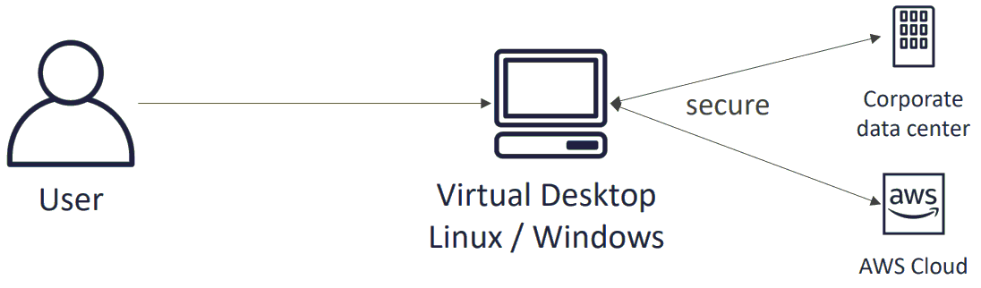
WorkSpaces Service
Is service that allows you to provision virtual, cloud-based Microsoft Windows, Amazon Linux desktops for your users
Users can access their virtual desktops from multiple devices or web browsers.
Great to eliminate management of on-premises VDI (Virtual Desktop Infrastructure)
Secure, Encrypted, Network Isolation
Integrated with Microsoft Active Directory
Tutorial: https://docs.aws.amazon.com/workspaces/latest/adminguide/amazon-workspaces.html

Slide 7
WorkSpaces Service
Demo
  https://www.youtube.com/watch?v=3BM8UvGNGX0

Slide 8
Assignment
  Self-practice

Slide 9
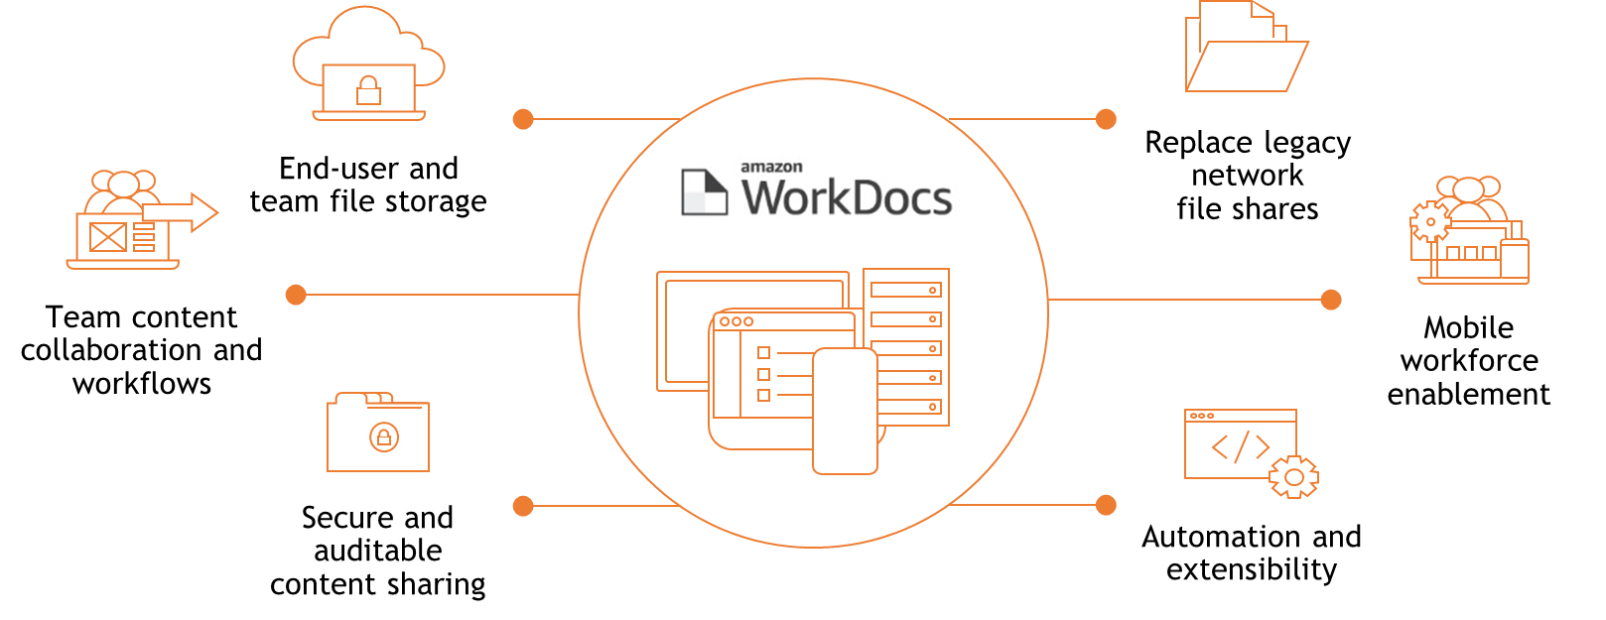
Workdocs Service
Is a fully managed, secure content creation, storage, and collaboration service
Easily create, edit, share content with others, provide rich feedback, collaboratively edit documents
Stored centrally on AWS, access it from anywhere on any device
Tutorial: https://docs.aws.amazon.com/workdocs/latest/adminguide/what_is.html

Slide 10
Workdocs Service
Demo
  https://www.youtube.com/watch?v=haQoDdeGOBo

Slide 11
Assignment
  Self-practice

Slide 12
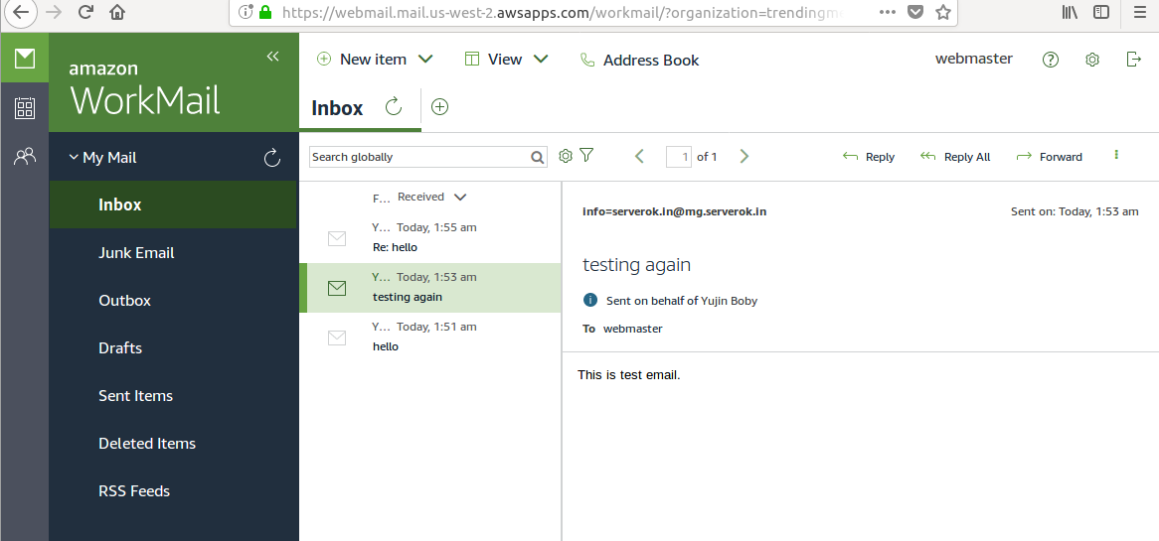
WorkMail Service
Is a secure, managed business email and calendar service (similar to Gmail, Outlook, ...)
Users can access their email, contacts, calendars using Microsoft Outlook, their browser, their native iOS / Android email applications
Tutorial: https://docs.aws.amazon.com/workmail/latest/adminguide/what_is.html

Slide 13
WorkMail Service
Demo
  https://www.youtube.com/watch?v=g3nDQ0-jxSU

Slide 14
Assignment
  Self-practice

Slide 15
Cost Management Service
Is service that allows you to visualize, understand, manage your AWS costs and usage over time
Features
  Cost Explorer (Support across all accounts)
    View, analyze your costs and usage
    Filter monthly, hourly, resource level
    Forecast usage
  Setup budget & Alarm
  Cost Anomaly Detection
Tutorial: https://docs.aws.amazon.com/cost-management/latest/userguide/what-is-costmanagement.html

Slide 16
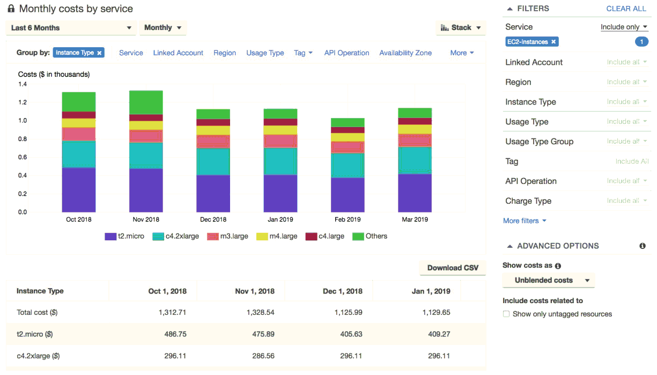
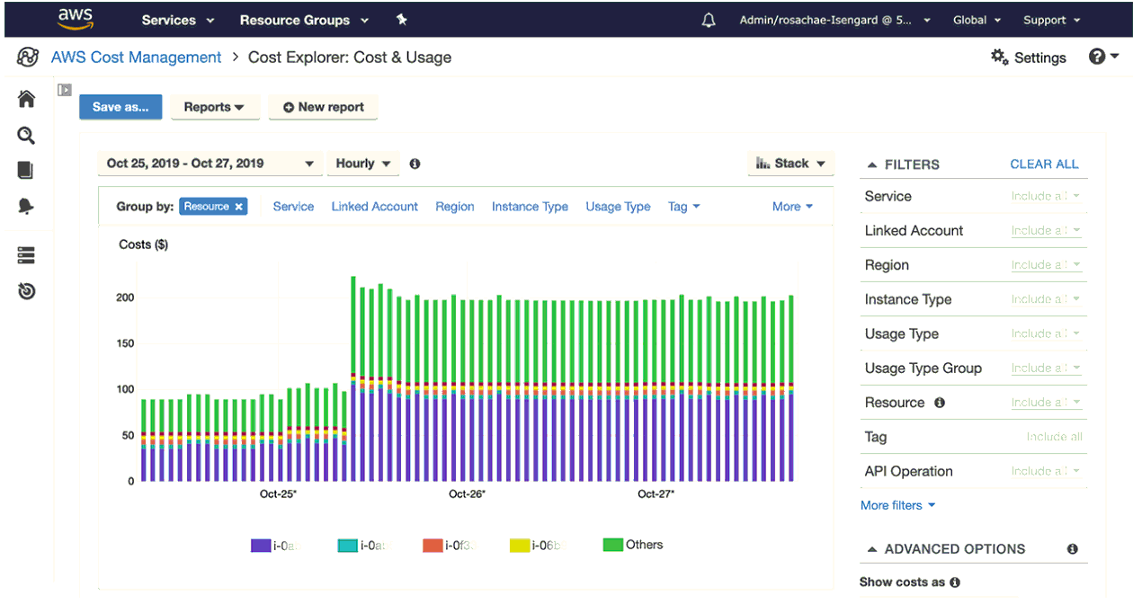
Cost Management Service
Monthly Cost
Hourly Cost
Monthly, hourly, resource level

Slide 17
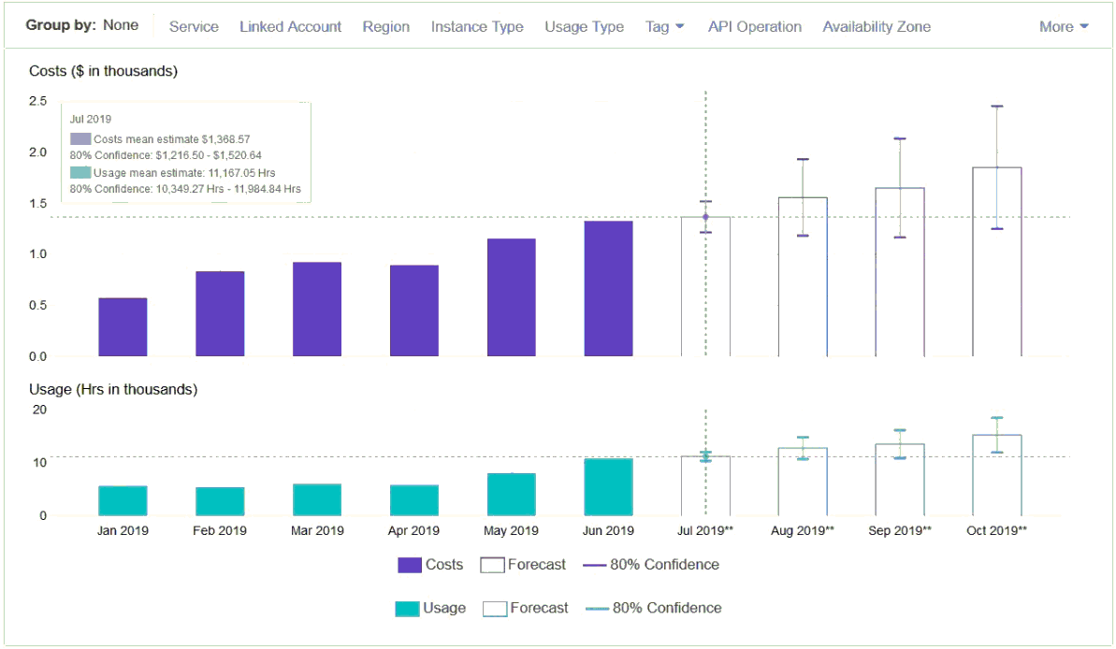
Cost Management Service
Forecast usage up to 12 months based on previous usage

Slide 18
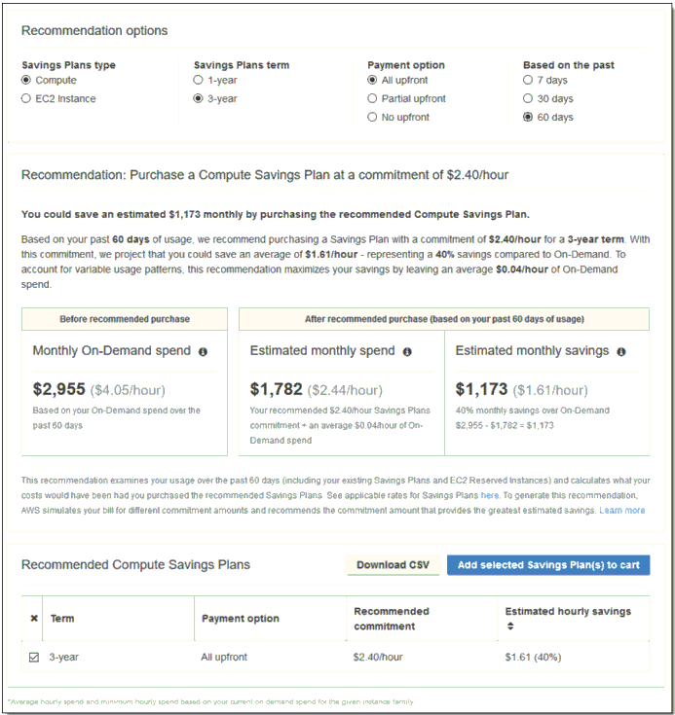
Cost Management Service
Savings Plan, Reserved Instances Recommendations

Slide 19
Cost Management Service
Demo
  https://www.youtube.com/watch?v=lfG2yKr9pQw

Slide 20
Assignment
  Self-practice

Slide 21
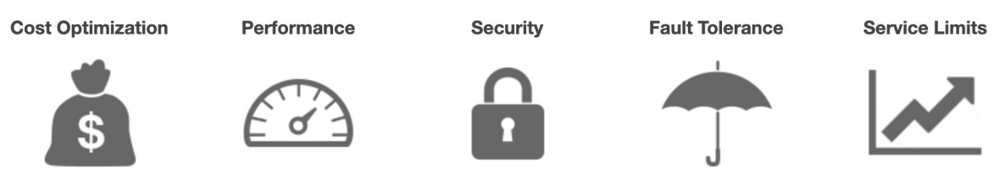
Trusted Advisor Service
Is service that analyze your AWS accounts, environment and provides recommendation to save money, improve system availability & performance, close security gaps
Features
  Cost Optimization
    Low utilization EC2 instances, idle load balancers, under-utilized EBS volumes…
    Reserved instances & savings plans optimizations
Tutorial: https://docs.aws.amazon.com/awssupport/latest/user/trusted-advisor.html

Slide 22
Trusted Advisor Service
  Performance
    High utilization EC2 instances, CloudFront CDN optimizations
    EC2 to EBS throughput optimizations, Alias records recommendations
  Security
    MFA enabled on Root Account, IAM key rotation, exposed Access Keys
    S3 Bucket Permissions for public access, security groups with unrestricted ports
  Fault Tolerance
    EBS snapshots age, Availability Zone Balance
    ASG Multi-AZ, RDS Multi-AZ, ELB configuration…

Slide 23
Trusted Advisor Service
Demo
  https://www.youtube.com/watch?v=i0IkKN9NoPk

Slide 24
Assignment
  Self-practice

Slide 25
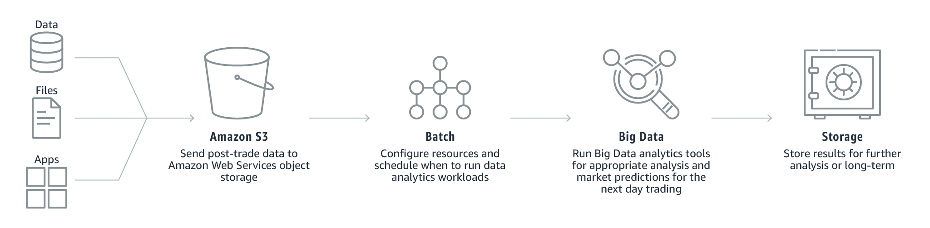
Batch Service
Is service that allows developers, scientists, engineers to easily, efficiently run hundreds of thousands of batch computing jobs on AWS
Dynamically provisions the optimal quantity and type of compute resources (CPU, memory optimized instances) based on the volume and specific resource requirements of the batch jobs submitted
Serverless service
Tutorial: https://docs.aws.amazon.com/batch/latest/userguide/what-is-batch.html

Slide 26
Batch Service
Demo
  https://www.youtube.com/watch?v=egipS1_ObIs
  https://www.youtube.com/watch?v=qPU9FzuAKIw

Slide 27
Assignment
  Self-practice

Slide 28
Other Service
Active Directory, Directory Service
X-Ray
SAM
Amplify
Control towner
Terraform
SAM
...

Slide 29
Q & A
Copyright © VTI Academy All Rights Reserved

